Slide 1
Object-Oriented Programming (OOP)
Week – 13
May 11-15, 2020
Instructor: Basit Ali
Email: basit.jasani@nu.edu.pk
Object-Oriented Programming (OOP)

Slide 2
Errors!
In software industrial programming most of the programs contain bugs. Bigger the program greater number of bugs it contains.
The following are mainly errors or bugs that occurred in any program:
Logical error: In this error the logic implemented is incorrect. This error occurs due to less concentration of programmer or poor knowledge of programmer regarding program.
Compilation error: This error is occurred due to use of wrong idiom, function or structure. This error is shown at compilation time of program.
Run Time error: This error occurred at the run time. This error occurs when program crashes during run time..

Slide 3
Exception!
An exception is a situation, which occurred by the runtime error. In other words, an exception is a runtime error. An exception may result in loss of data or an abnormal execution of program.
It is a new feature that ANSI C++ included in it. Now almost all C++ compilers support this feature.

Slide 4
Exceptions!
Exceptions are different, however. You can't eliminate exceptional circumstances; you can only prepare for them. Your users will run out of memory from time to time, and the only question is what you will do. Your choices are limited to these:
Crash the program.
Inform the user and exit gracefully.
Inform the user and allow the user to try to recover and continue.
Take corrective action and continue without disturbing the user.

Slide 5
Exceptions!
Exception provides a method to control exceptional conditions (like run time error) or to control any crashed program by transferring control to some special functions called handler.
We can use following the keywords or functions to control runtime error in C++:
try {}
catch {}
throw()

Slide 6
try {} block
This block captures series of errors in any program at runtime and throw it to the catch block where user can customize the error message.
Syntax:
try
{
//define program;
throw(variable);
}

Slide 7
catch {} block
This block catches the error thrown by try block. This block contains method to customize error.
Syntax:
catch
{
//defines method to control error;
}

Slide 8
throw function
This function is used to transfer the error from try block to catch block. This function plays major role to save program from crashing.
Syntax:
throw(variable);

Slide 9
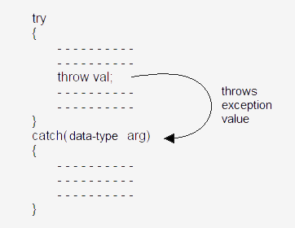
Exception Flow!

Slide 10
try-blocks and if-else
try-blocks are very similar to if-else statements
If everything is normal, the entire try-block is executed
else, if an exception is thrown, the catch-block is executed
A big difference between try-blocks and if-else statements is the try-block's ability to send a message to one of its branches

Slide 11
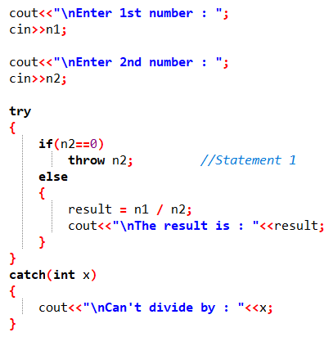
Example of simple try-throw-catch

Slide 12
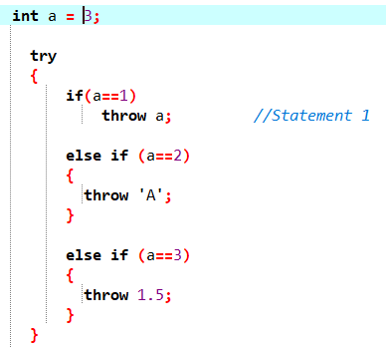
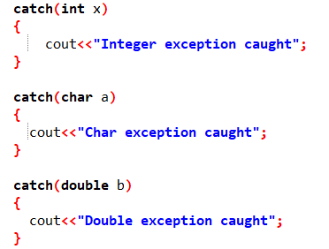
Multiple Catches

Slide 13
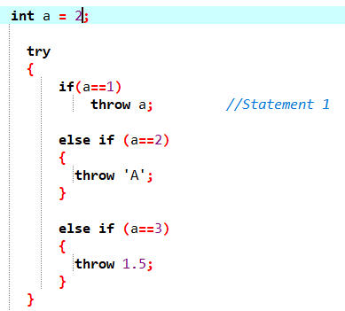
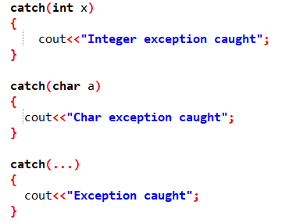
Catch all exceptions / Default Catch

Slide 14
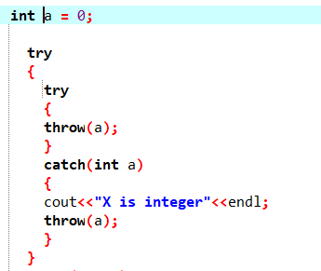
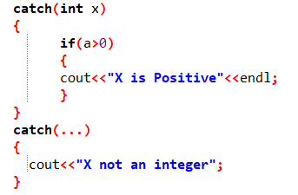
Nested Exception

Slide 15
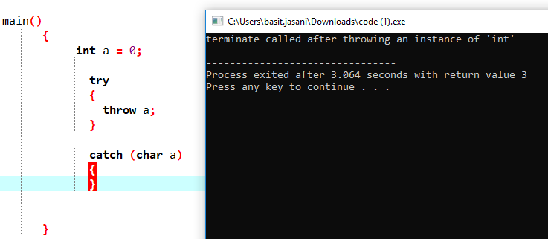
Exception not caught anywhere

Slide 16
Concept!
When an exception is thrown, all objects created inside the enclosing try block are destructed before the control is transferred to catch block.

Slide 17
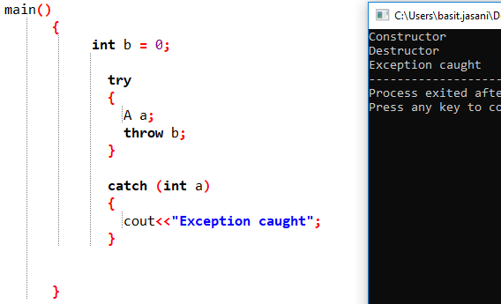
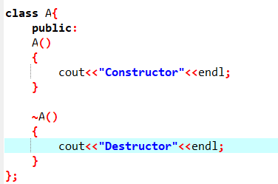
Example!

